Slide 1
Big Data 101:
Session 3

Slide 2
Some Housekeeping
Project Ideas ➔ What do you have so far
Row Four, I need your list
Class Schedule Juggling

Slide 3
Week 3 – Topics
Storage and Compute: HDFS, Map Reduce
Resource Management
Special Guest Star
Chris Narouth – PMC Member of Apache Hadoop Project

Slide 4
Homework
Look through the Hadoop docs.
Use HDFS Command Line to:
View a Directory
Get a report via dfsadmin
Create a directory
Copy a file from local to HDFS
Copy a file from HDFS to local
Do the above with WebHDFS

Slide 5
HDFS

Slide 6
HDFS Overview
File split into blocks of 64MB
Each block replicated 3x
NameNode
DataNode 1
DataNode 2
DataNode 3
DataNode 4
DataNode 5
DataNode 6
Block 1
Block 3
Block 4
Block 1
Block 4
Block 1
Block 2
Block 4
Block 2
Block 3
Block 2
Block 3

Slide 7

HDFS Overview

Slide 8
Using HDFS
Command Line
bin/hdfs dfs –help
bin/hdfs dfsadmin
API
Java
libHDFS
Hadoop Streaming
WebHDFS – REST
Web Interface
http://namenode-name:50070/
Ambari and Hue
JMX
http://namenode-name:50070/jmx

Slide 9
Map Reduce, Yarn and Tez

Slide 10
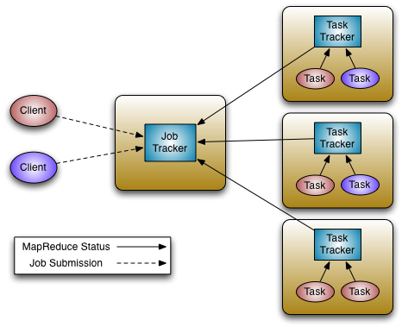
Map Reduce V1 Architecture
JobTracker
Manages cluster resources and job scheduling
TaskTracker
Per-node agent
Manage tasks

Slide 11
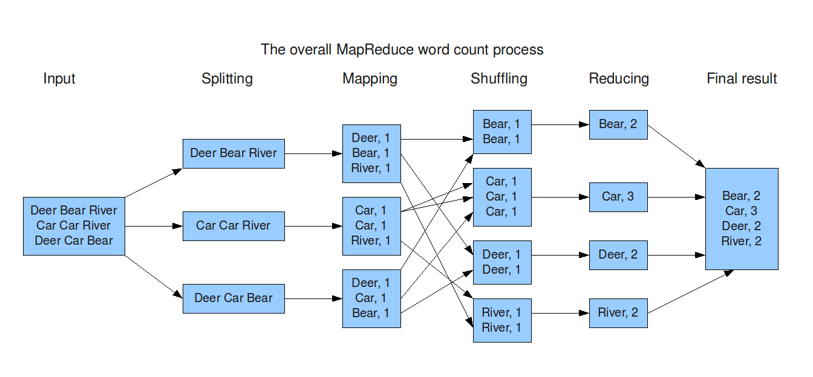
Map Reduce

Slide 12
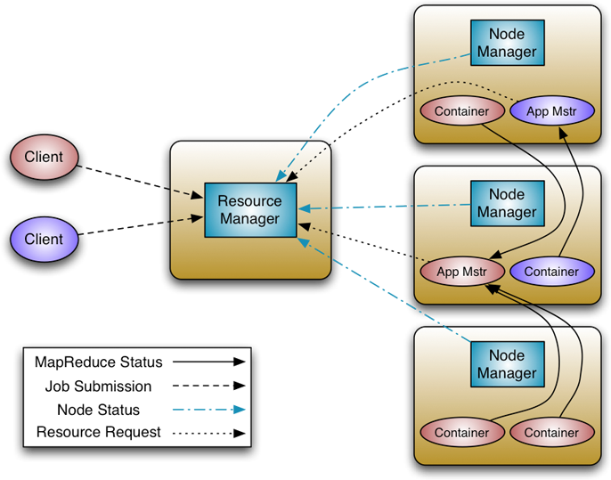
YARN
Resource Manager
Global resource scheduler
Hierarchical queues
Node Manager
Per-machine agent
Manages the life-cycle of container
Container resource monitoring
Application Master
Per-application
Manages application scheduling and task execution
E.g. MapReduce Application Master

Slide 13
Capacity Scheduler Config
ROOT
yarn.scheduler.capacity.root.capacity=100
yarn.scheduler.capacity.root.queues=adhoc,batch,prod
ADHOC
yarn.scheduler.capacity.root.adhoc.acl_submit_applications=*
yarn.scheduler.capacity.root.adhoc.capacity=25
yarn.scheduler.capacity.root.adhoc.maximum-capacity=50
yarn.scheduler.capacity.root.adhoc.state=RUNNING
yarn.scheduler.capacity.root.adhoc.user-limit-factor=2
PROD
yarn.scheduler.capacity.root.prod.acl_administer_queue=yarn
yarn.scheduler.capacity.root.prod.acl_submit_applications=yarn,mapred
yarn.scheduler.capacity.root.prod.capacity=50
yarn.scheduler.capacity.root.prod.queues=reports,ops
PROD - Reports
yarn.scheduler.capacity.root.prod.reports.state=RUNNING
yarn.scheduler.capacity.root.prod.reports.capacity=80
yarn.scheduler.capacity.root.prod.reports.maximum-capacity=100
yarn.scheduler.capacity.root.prod.reports.user-limit-factor=3
yarn.scheduler.capacity.root.prod.reports.minimum-user-limit-percent=20
yarn.scheduler.capacity.prod.reports.maximum-applications = 1

Slide 14
Hive-on-MR v. Hive-on-Tez
SELECT a.state, COUNT(*), AVERAGE(c.price)
FROM a
JOIN b ON (a.id = b.id)
JOIN c ON (a.itemId = c.itemId)
GROUP BY a.state
Tez avoids unneeded writes to HDFS
Hive – MR | Hive – Tez
M
M
M
SELECT a.state,
c.itemId
M
M
M
SELECT a.state
SELECT b.id
R
R
R
R
SELECT b.id
HDFS
M
M
M
M
JOIN (a, c)
SELECT c.price
M
M
R
R
R
HDFS
JOIN (a, c)
R
HDFS
JOIN(a, b)
GROUP BY a.state
COUNT(*)
AVERAGE(c.price)
M
M
JOIN(a, b)
GROUP BY a.state
COUNT(*)
AVERAGE(c.price)
R
R
Notes:
Hive and Pig jobs no longer need to move to the end of the queue between steps in the pipeline.

Slide 15
Roles
Existing Resources
Hadoop
Resources
Enterprise or Application
Architect
Hadoop Architect
Data Architect
Data Wrangler
Data or BI Analyst
Analyst or Data Scientist
Developer (Java/Scripting, Python, Ruby, etc…)
Hadoop Application
Developer
Linux/Windows
Administrator
Hadoop Admin

Slide 16
Homework
Run some of the MapReduce Examples:
PI on Yarn
Pi on Map reduce
Whats the estimated value of Pi
Whats the difference in speed?
Run Terasort and TeraGen Examples
teragen <num rows> <output dir>
terasort <input dir> <output dir>
Do the Wordcount Assignment – I will post this on Canvas

Slide 17
Additional Sources
Hadoop Docs – http://hadoop.apache.org/docs/current/
WebHDFS Docs – http://hadoop.apache.org/docs/current/hadoop-project-dist/hadoop-hdfs/WebHDFS.html
REST Clients
Postman Extension for Chrome – https://www.getpostman.com/
wget from command line (Mac and Linux)
Fiddler for Windows – http://www.telerik.com/download/fiddler
Murthy, Arun. Apache Hadoop: Yarn. Addison Wesley. Chapter 2.
http://www.informit.com/articles/article.aspx?p=2190194&seqNum=3

